Slide 1
Profiling QML
Stanley Morris / OC Qt/QML Meetup

Slide 2
Agenda
Causes of performance issues
Demo of QML Profiler
Environment Variables

Slide 3
Causes of performance issues
JavaScript handlers > 16ms
look for gaps in timeline
Drawing hidden Items
Use QSG_VISUALIZE=overdraw
Long running C++ operations
Not visible in QML Profiler

Slide 4
Environment Variables
QSG_VISUALIZE
Values: batches, clip, changes, overdraw
QSG_RENDERER_DEBUG=render
QSG_RENDER_TIMING=timing
QSG_RENDER_LOOP
Values: basic, windows, threaded

Slide 5
Environment Variables
See PerformanceTest/main.cpp line 7
Uncomment in see impact:
// qputenv("QSG_VISUALIZE", "batches");
// qputenv("QSG_VISUALIZE", "clip");
// qputenv("QSG_VISUALIZE", "changes");
qputenv("QSG_VISUALIZE", "overdraw");
// qputenv("QSG_RENDERER_DEBUG", "render");

Slide 6
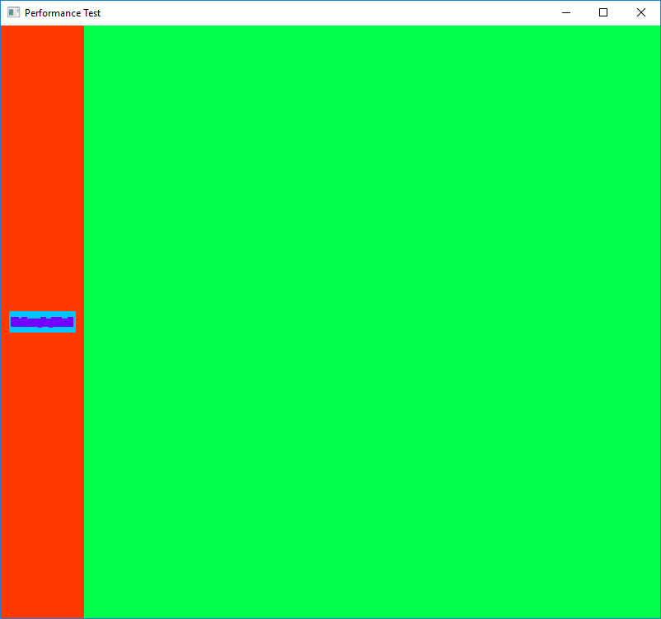
QSG_VISUALIZE=batches
http://doc.qt.io/qt-5/qtquick-visualcanvas-scenegraph-renderer.html #visualizing-batches
Merged batches are drawn in a solid color.
Fewer colors is better
Unmerged batches are drawn with diagonal lines
Many individual batches will reduce performance.

Slide 7
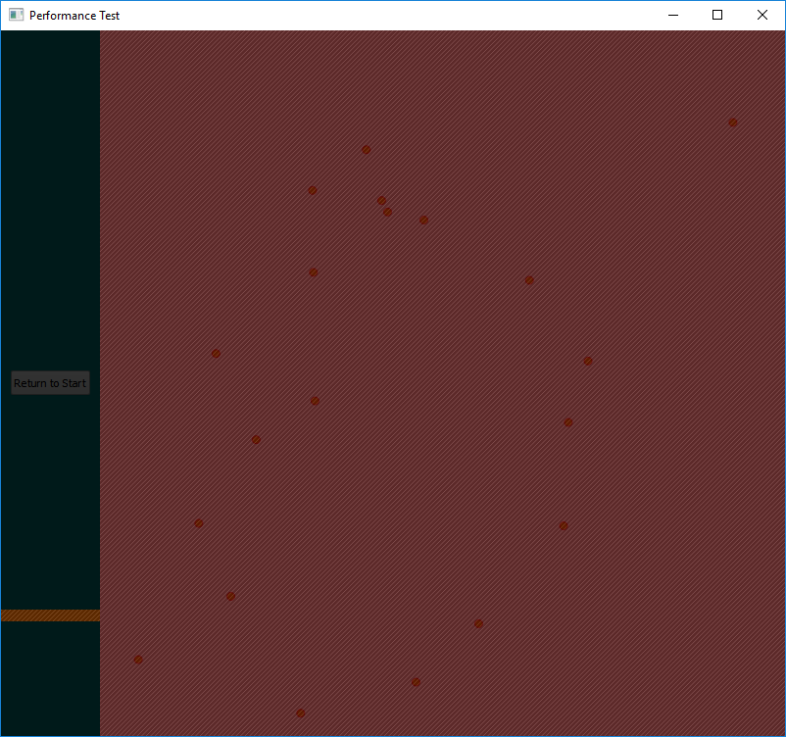
QSG_VISUALIZE=clip
http://doc.qt.io/qt-5/qtquick-visualcanvas-scenegraph-renderer.html #visualizing-clipping
Red areas indicate clipping.
Clipping is often a hack for bad design that would show visual details that could be avoided with the proper QML component. For example: clipping objects created using a Repeater; a ListView would be more appropriate because it only creates objects that fit in the ListView’s bounds.

Slide 8
QSG_VISUALIZE=changes
http://doc.qt.io/qt-5/qtquick-visualcanvas-scenegraph-renderer.html #visualizing-changes
Quickly identify areas responding to signals at too frequently
Changes are visualized with a flash of color
Do not use if you haven’t taken your epilepsy medicine!

Slide 9
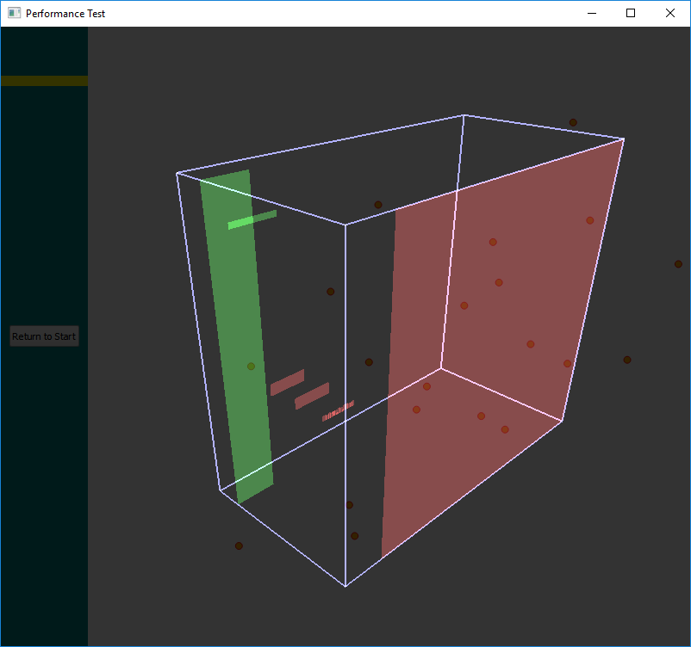
QSG_VISUALIZE=overdraw
http://doc.qt.io/qt-5/qtquick-visualcanvas-scenegraph-renderer.html#visualizing-overdraw
Renders in 3D to identify overdrawn items.
Awesome tool for identifying:
Hidden Items that should be set visible: false
Items rendering outside the viewable area

Slide 10
QSG_RENDERER_DEBUG=render
http://doc.qt.io/qt-5/qtquick-visualcanvas-scenegraph-renderer.html#performance
Statistics on how well the batching goes:
How many batches
Which batches are retained in video memory or uploaded every cycle
Which are opaque and alpha blended, which is more time consuming
Best performance with less than 10 batched and at least 3-4 of them opaque.

Slide 11
QSG_RENDER_TIMING=1
http://doc.qt.io/qtcreator/creator-qml-performance-monitor.html #analyzing-scene-graph-events
Display detailed information on scene graph events:
Threading model
Time spent performing OpenGL operations

Slide 12
QSG_RENDER_LOOP
http://doc.qt.io/qt-5/qtquick-visualcanvas-scenegraph.html#scene-graph-and-rendering
Use to verify that correct loop type is used by system. You can force a loop type, but there is usually an underlying problem when Qt chooses the wrong loop type.
basic
Single-threaded, timer-controlled rendering
windows
Single-threaded, OpenGl-synced rendering
threaded
Dedicated rendering thread. Best performance for multi-core CPU.

Slide 13
Resources
Ulf Hermann’s QtDD14 QML Profile Presentation
https://www.youtube.com/watch?v=TiJiF0MOOFc&feature=youtu.be
Qt Profiling QML Applications Documentation
http://doc.qt.io/qtcreator/creator-qml-performance-monitor.html

